Slide 1

Anchor function for studying language models
Zhi-Qin John Xu
Shanghai Jiao Tong University
Friday, March 29, 2024
Notes:
Science empowers deep learning

Slide 2
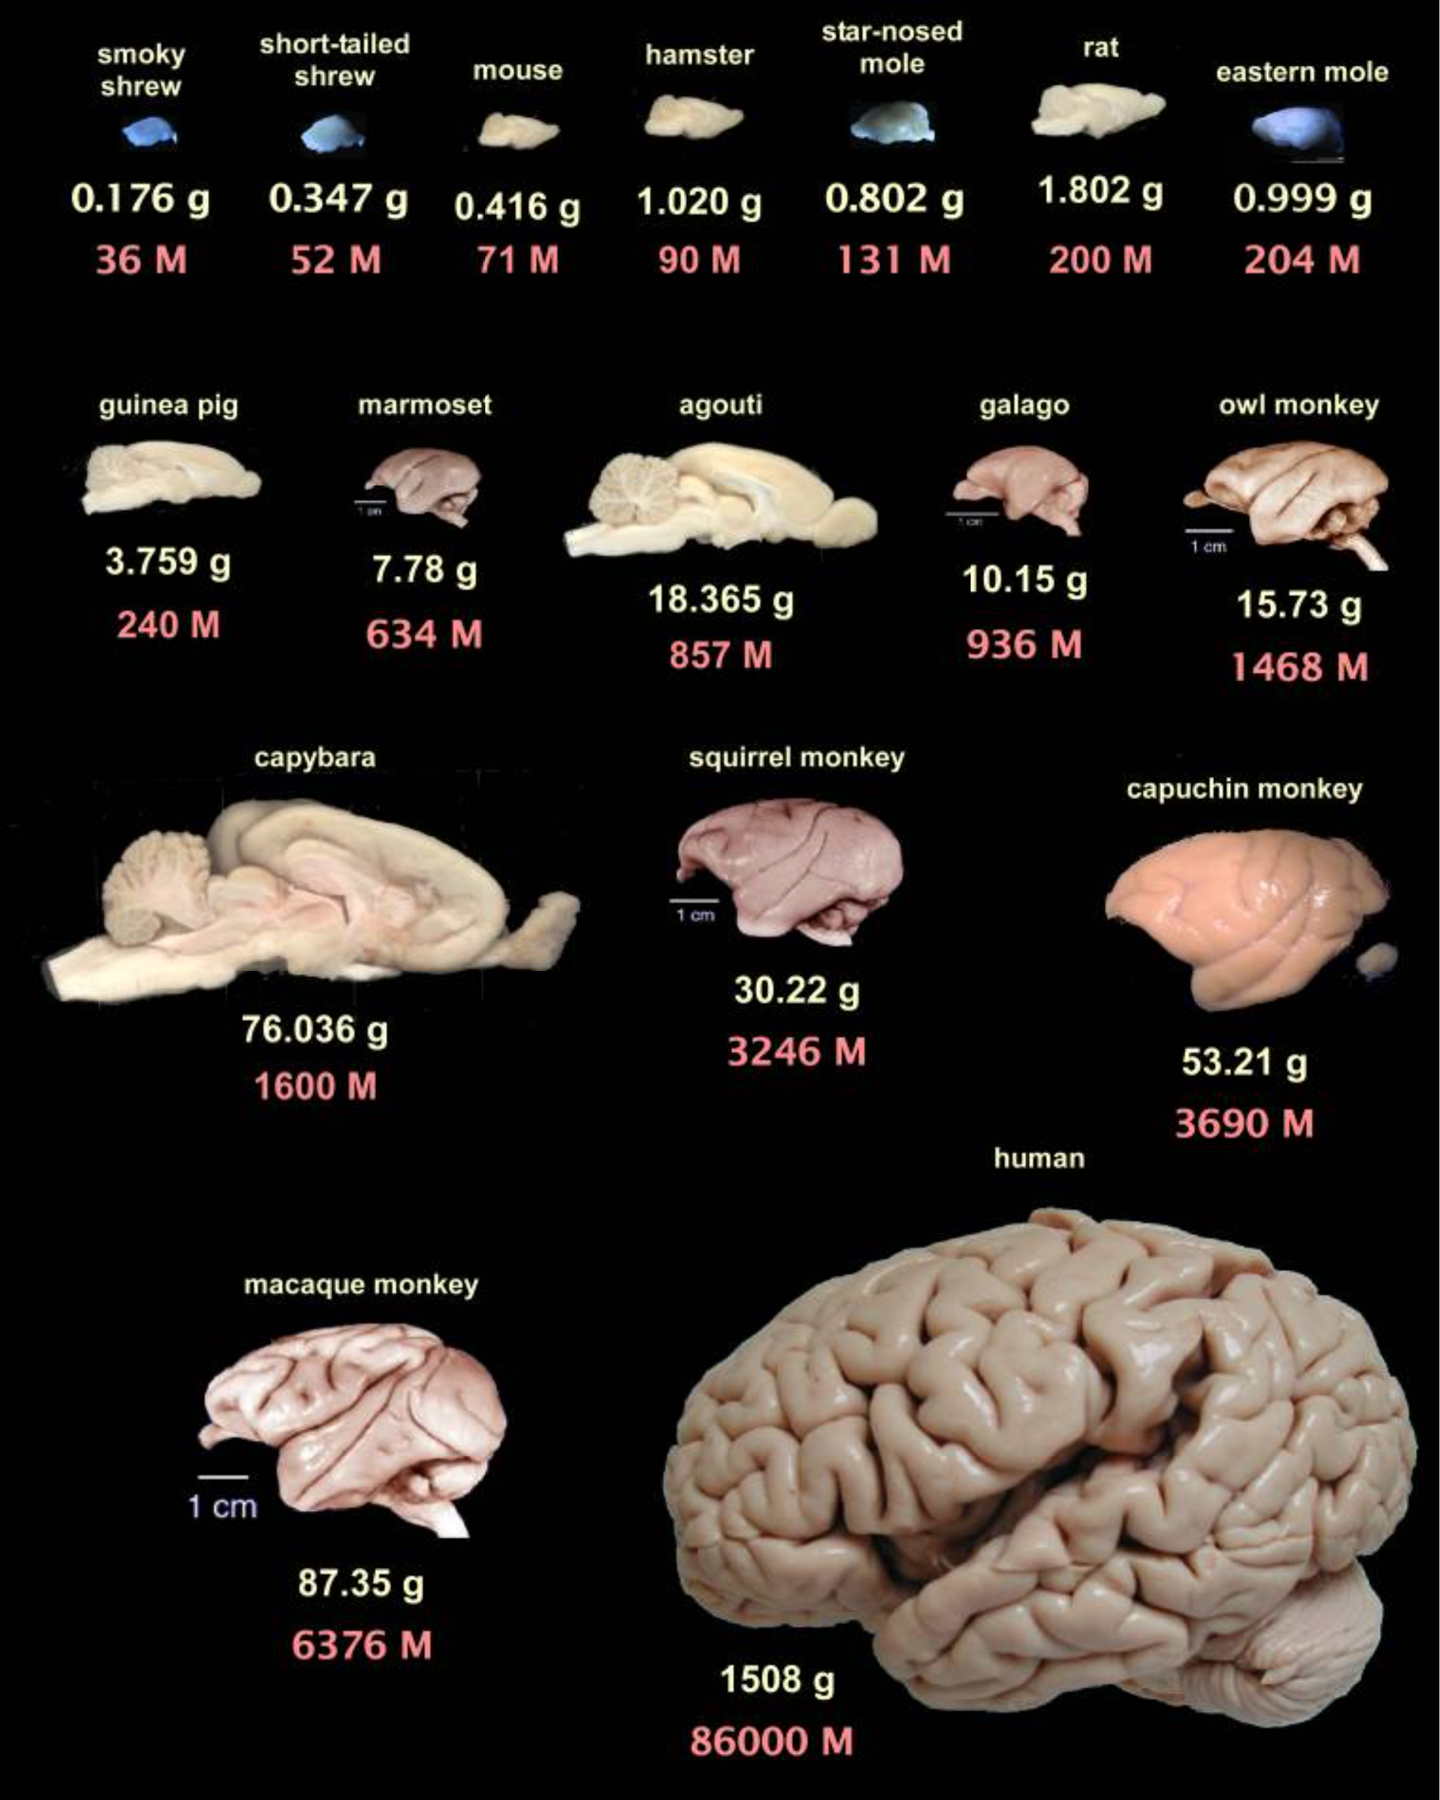
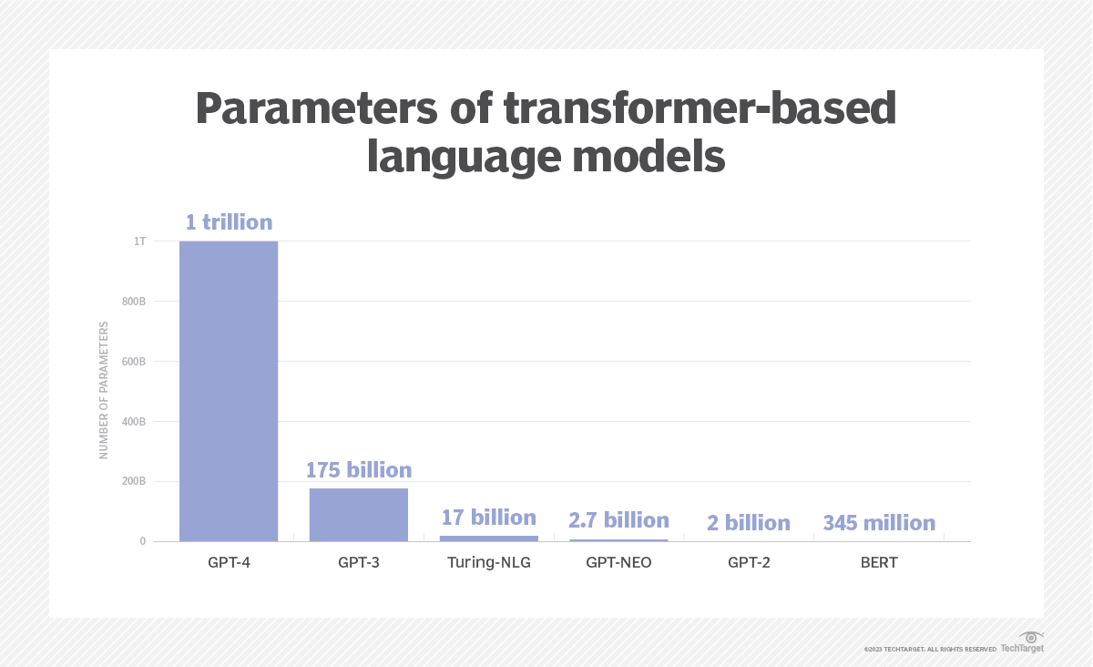
Increasingly large size

Slide 3
Difficulties
Complex data structure.
“calculate the product of the first two numbers: 10, 20, 30”
alternative ways
Multiple tokens together to execute an operation
Training and test boundary
reversal curse
“Who is Tom Cruise’s mother?” && “Who is Mary Lee Pfeiffer’s son?” Hard to check which is more frequent.
Unknown target functions.
Large computational cost and memory for academic groups
prepare data for a specific task
Interpretability for the inferring process.
……

Slide 4
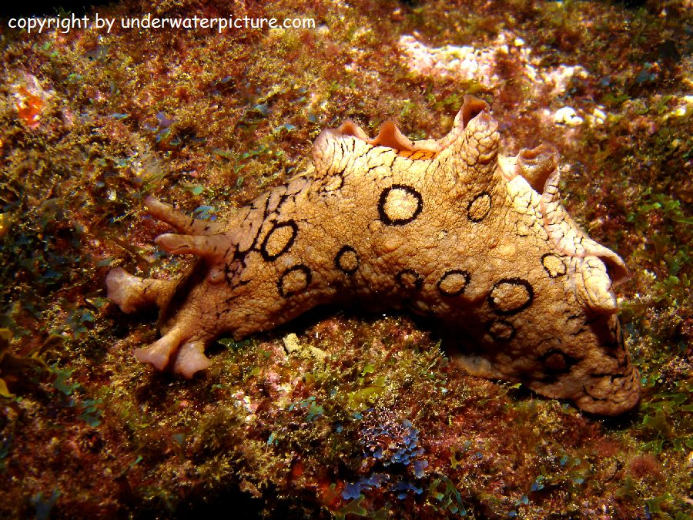
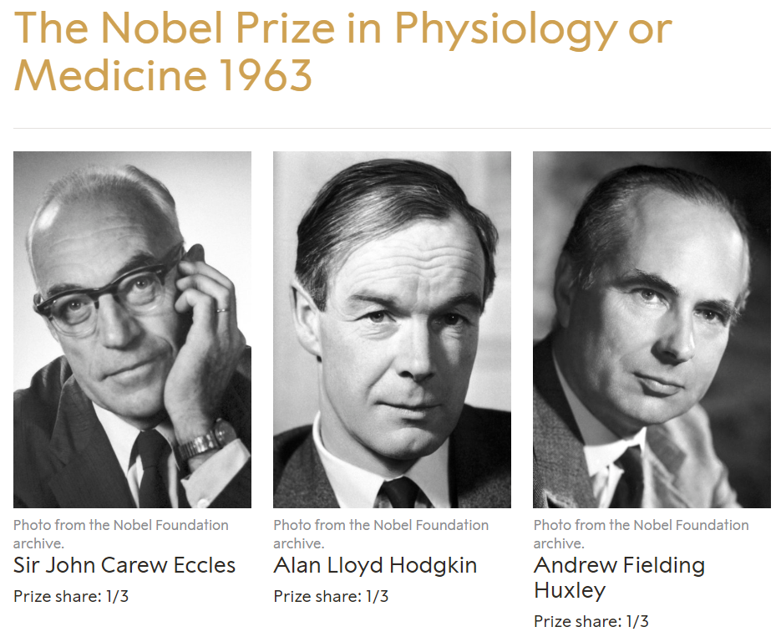
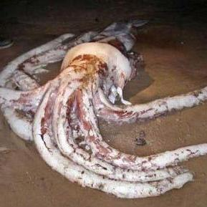
How to study?
Aplysia: neurobiologists' research model
Hodgkin-Huxley (HH) model (Nobel Prize in Medicine)
Easy to record
The nervous system is distributed along the body
Controls feeding, escape responses, and swimming
The number of neurons is relatively small.
Based on data summarization of nerve stimulation potentials in squids
In most animals, axons are too small to insert electrodes
The giant squid's axon diameter can reach 1 millimeter
Notes:
海兔(Aplysia) 神经生物学家的研究模型 1、细胞大 0.8~1毫米 记录容易 2、神经系统沿着身体分布，而不是集中在头部 3、控制摄食、逃避反应以及游泳等 4、神经元数量比较少 1000~2000个 Hodgkin-Huxley (HH) 模型(1963 诺贝尔医学奖)1、解释动作电位的产生和传播2、基于对乌贼的神经刺激电位进行数据总结3、大多数动物中，轴突太小，无法在不损坏细胞的情况下插入电极4、巨型乌贼的轴突直径可达 1 毫米

Slide 5

How to study?
Conducting diabetes research using mice
Biological similarity: Mice have a high degree of physiological and genetic similarity to humans.
Low time consumption: Mice have a shorter life cycle.
High cost-effectiveness: Mice are easier to breed and maintain, resulting in lower research costs.
Manipulable and controllable variables: Mice genes can be easily modified, enabling the creation of specific gene knockout or knockin models.
Notes:
用小白鼠进行糖尿病研究 1、生物间相似性：小鼠与人类在生理和遗传学上有很高的相似性，很多人类基因的功能在小鼠身上有相似的基因对应 2、时间花费低：小鼠的生命周期较短，研究人员可以可以花费更少的时间成本，观察到疾病的全过程 3、成本效益高：与其他较大的哺乳动物模型相比，小鼠更容易饲养和繁殖，研究成本更低 4、可人为操控修改，易于控制变量：小鼠的基因容易通过遗传工程技术进行修改，可以创建特定基因敲除或敲入的模型，用于研究这些基因在糖尿病发病中的作用

Slide 6
Characteristics of language: anchor-key pattern
“I am from China, my name is john, I like reading.”
What is his name?
What does he like?
Where is he from?
“summation of 1,16,17” and “product of 1,16,17”
Multiple expressions for an operation
“calculate the product of the first two numbers: 10, 20, 30”
“compute the sum of the first number and the second number: 10, 20, 30”.

Slide 7
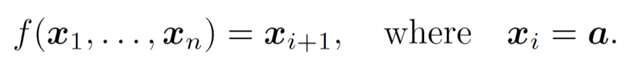
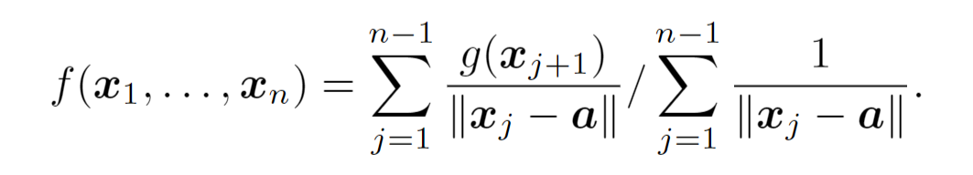
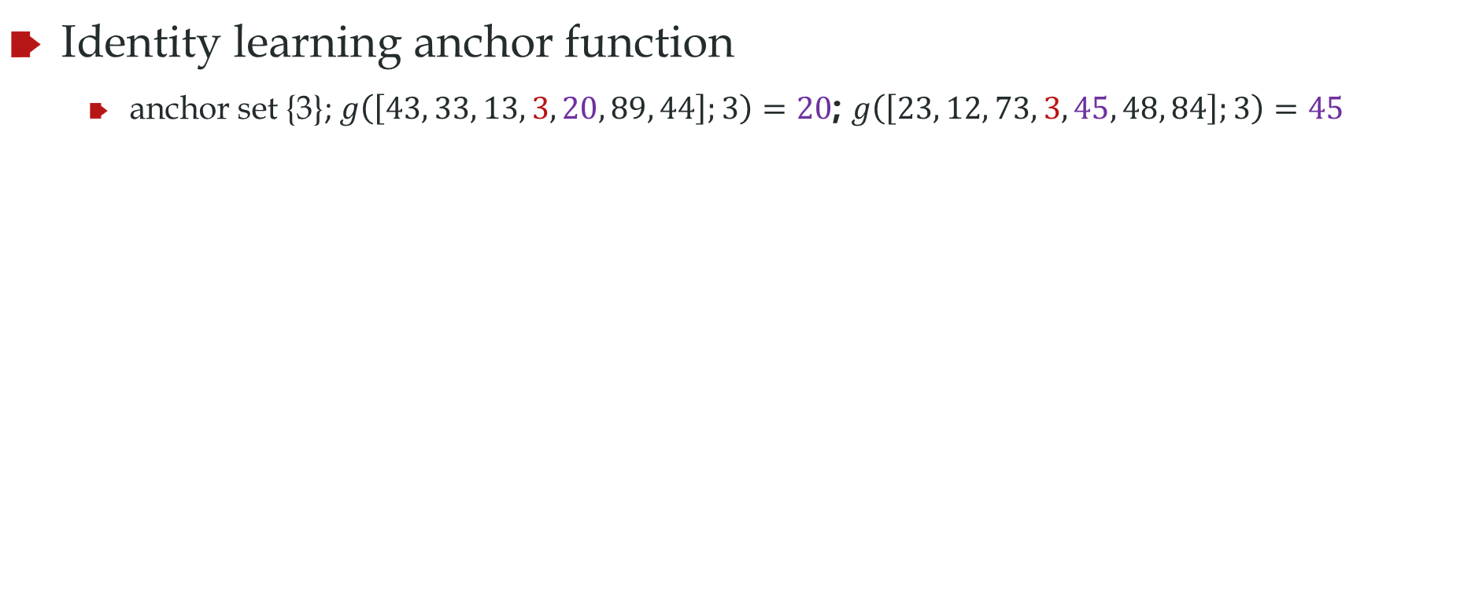
Anchor function
anchor set A
Identity learning anchor function
anchor set {3}; $g\left(\left[43, 33, 13, 3, 20, 89, 44\right];3\right)=20$; $g\left(\left[23, 12, 73, 3, 45, 48, 84\right];3\right)=45$

Slide 8
Remarks
anchor set A
It is a type of function to simulate several language tasks
We will show transformer can do anchor function well
We will understand why transformer can work well for anchor function
We will extend our understands to LLMs

Slide 9
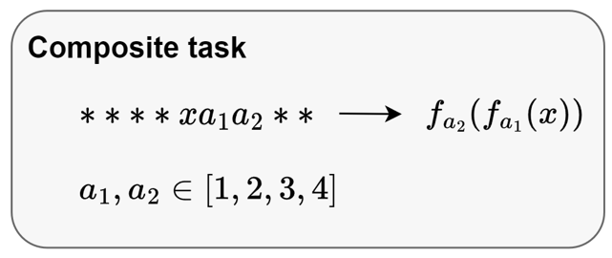
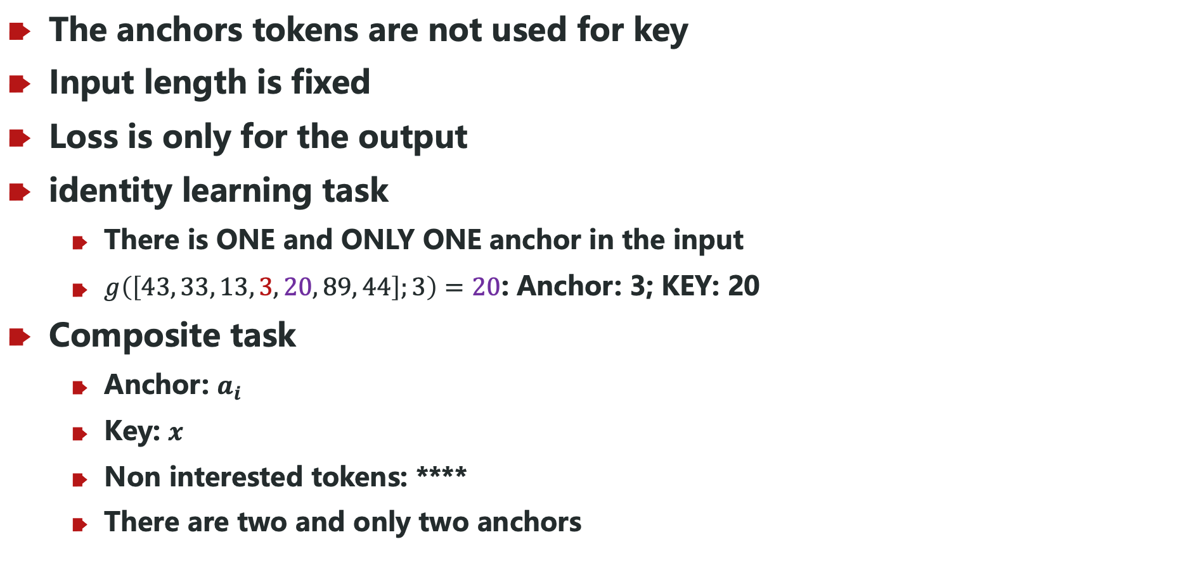
Anchor function
The anchors tokens are not used for key
Input length is fixed
Loss is only for the output
identity learning task
There is ONE and ONLY ONE anchor in the input
$g\left(\left[43, 33, 13, 3, 20, 89, 44\right];3\right)=20$: Anchor: 3; KEY: 20
Composite task
Anchor: $a_{i}$
Key: $x$
Non interested tokens: ****
There are two and only two anchors

Slide 10
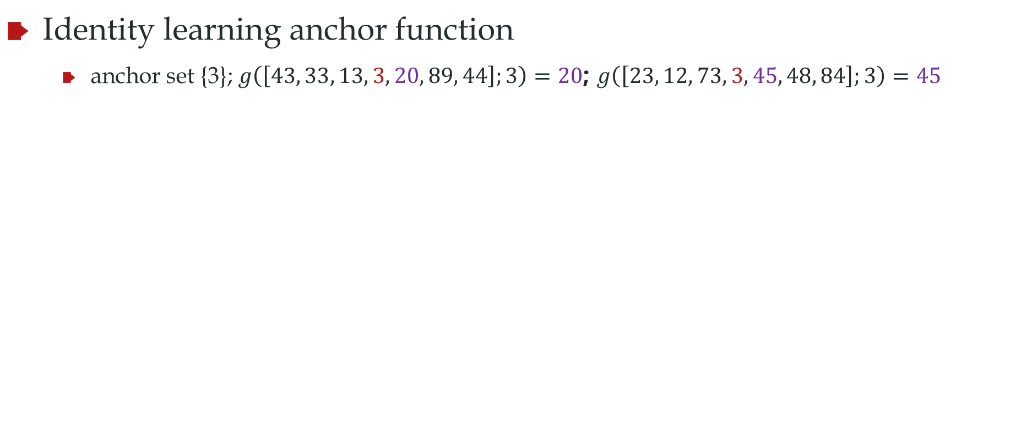
Anchor function: training and test data
anchor set A
Identity learning anchor function
anchor set {3}; $g\left(\left[43, 33, 13, 3, 20, 89, 44\right];3\right)=20$; $g\left(\left[23, 12, 73, 3, 45, 48, 84\right];3\right)=45$
3X to X, X ranges:
Training data [20,60]
Test data [61,80]
NN never sees [61,80]

Slide 11
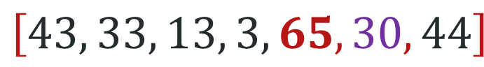
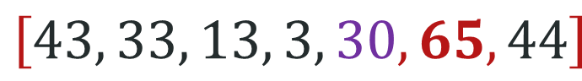
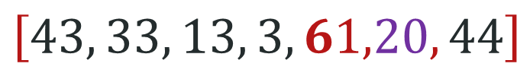
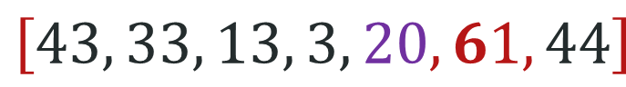
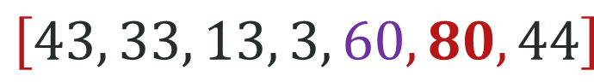
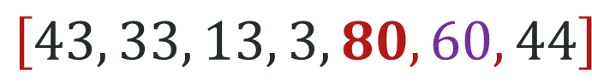
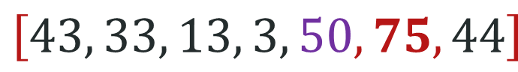
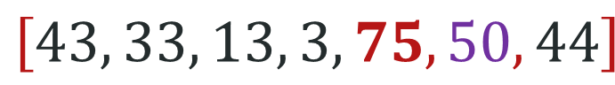
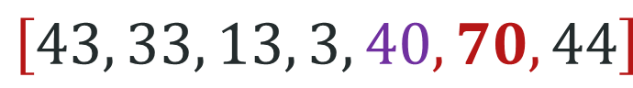
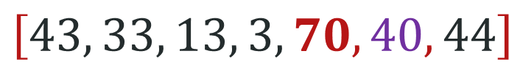
Question
Can this work?
Training set
Test set
$$\left[43, 33, 13, 3, 20, 61, 44\right]$$
$$\left[43, 33, 13, 3,61,20, 44\right]$$
$$\left[43, 33, 13, 3, 30, 65, 44\right]$$
$$\left[43, 33, 13, 3,65,30, 44\right]$$
$$\left[43, 33, 13, 3, 40, 70, 44\right]$$
$$\left[43, 33, 13, 3,70,40, 44\right]$$
$$\left[43, 33, 13, 3, 50,75, 44\right]$$
$$\left[43, 33, 13, 3,75,50, 44\right]$$
$$\left[43, 33, 13, 3, 60, 80, 44\right]$$
$$\left[43, 33, 13, 3,80,60, 44\right]$$

Slide 12
No, it is not.
Loss only here
Output:
*
*
*
*
*
*
*
X
Model
Only this information flow needs to be changed during BP
Each token outputs a token
Embedding
E1
E2
E3
E4
E5
E6
E7
E8
Blue embedding can not be learned
Input:
*
*
*
3
X
*
*
*

Slide 13
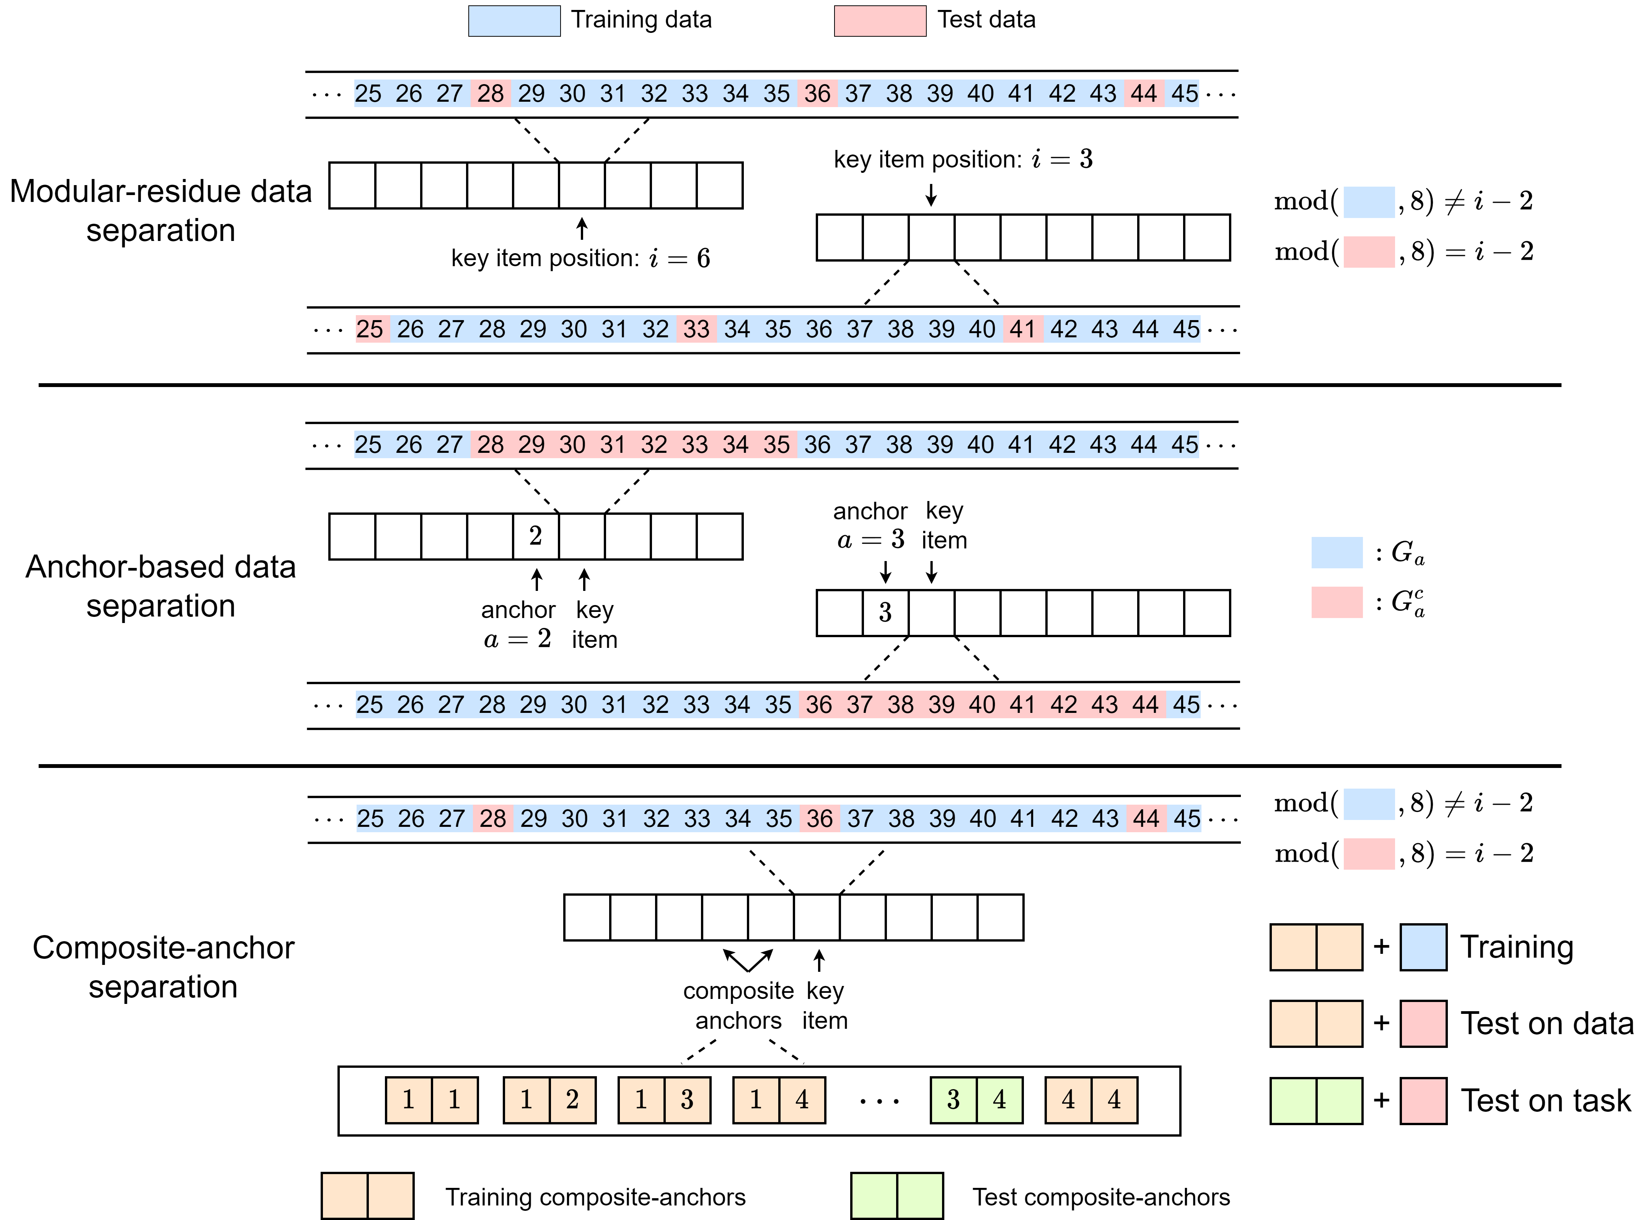
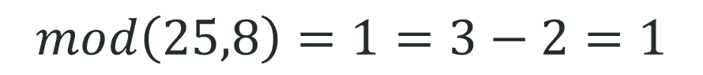
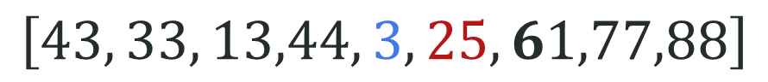
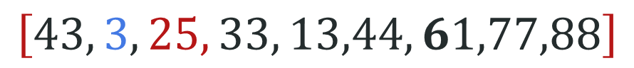
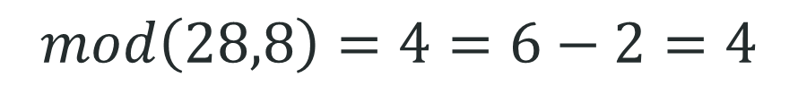
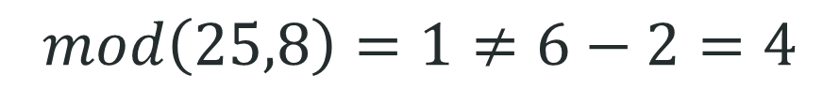
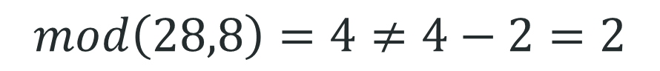
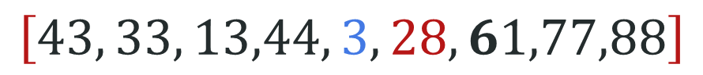
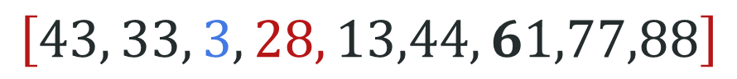
Anchor function: training and test data
Train
$$\left[43, 33, 13,44, 3, 25, 61,77,88\right]$$
$$mod\left(25,8\right)=1≠6−2=4$$
$$\left[43, 33, 3, 28, 13,44, 61,77,88\right]$$
$$mod\left(28,8\right)=4≠4−2=2$$
Test
$$\left[43, 3, 25, 33, 13,44, 61,77,88\right]$$
$$mod\left(25,8\right)=1=3−2=1$$
$$\left[43, 33, 13,44, 3, 28, 61,77,88\right]$$
$$mod\left(28,8\right)=4=6−2=4$$

Slide 14
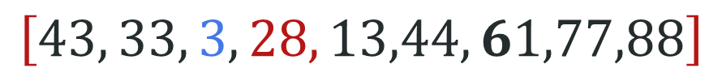
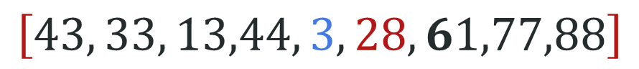
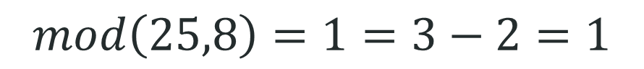
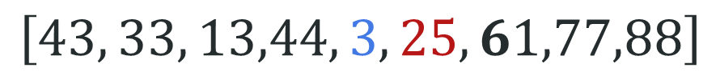
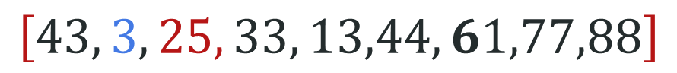
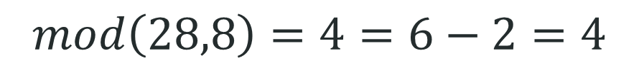
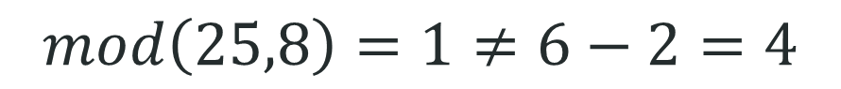
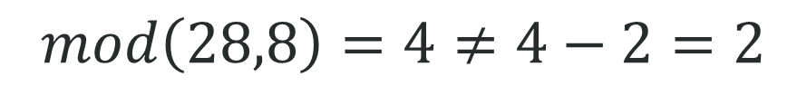
Would it just remember all pairs?
Train
$$\left[43, 33, 13,44, 3, 25, 61,77,88\right]$$
$$mod\left(25,8\right)=1≠6−2=4$$
$$\left[43, 33, 3, 28, 13,44, 61,77,88\right]$$
$$mod\left(28,8\right)=4≠4−2=2$$
Test
$$\left[43, 3, 25, 33, 13,44, 61,77,88\right]$$
$$mod\left(25,8\right)=1=3−2=1$$
$$\left[43, 33, 13,44, 3, 28, 61,77,88\right]$$
$$mod\left(28,8\right)=4=6−2=4$$

Slide 15
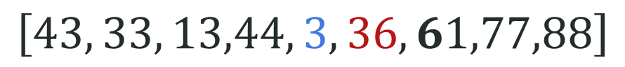
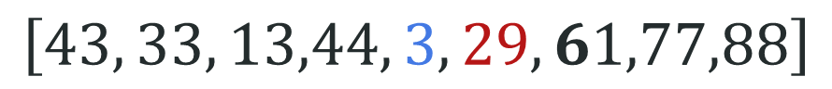
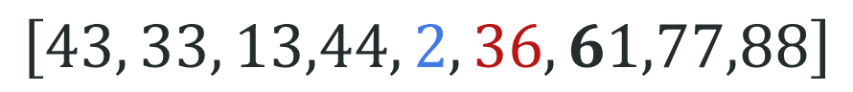
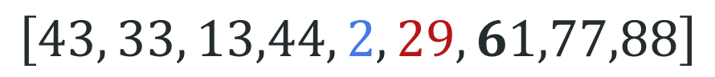
Anchor function: training and test data
$$\left[43, 33, 13,44, 2, 29, 61,77,88\right]$$
Never seen
$$\left[43, 33, 13,44, 3, 36, 61,77,88\right]$$
$$\left[43, 33, 13,44, 3, 29, 61,77,88\right]$$
Seen in training
$$\left[43, 33, 13,44, 2, 36, 61,77,88\right]$$

Slide 16
Anchor function: training and test data

Slide 17
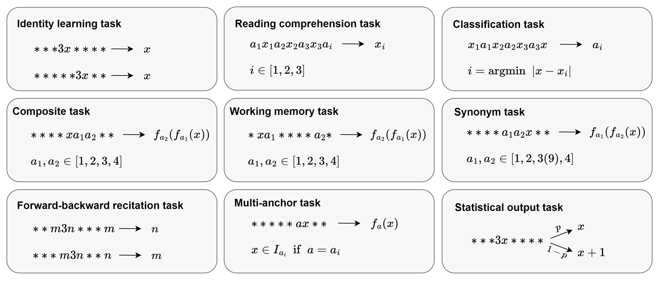
Anchor function

Slide 18
Study on different tasks

Slide 19
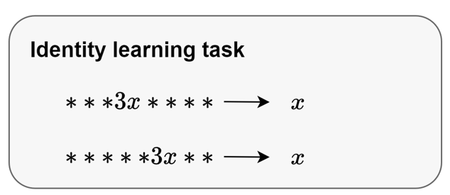
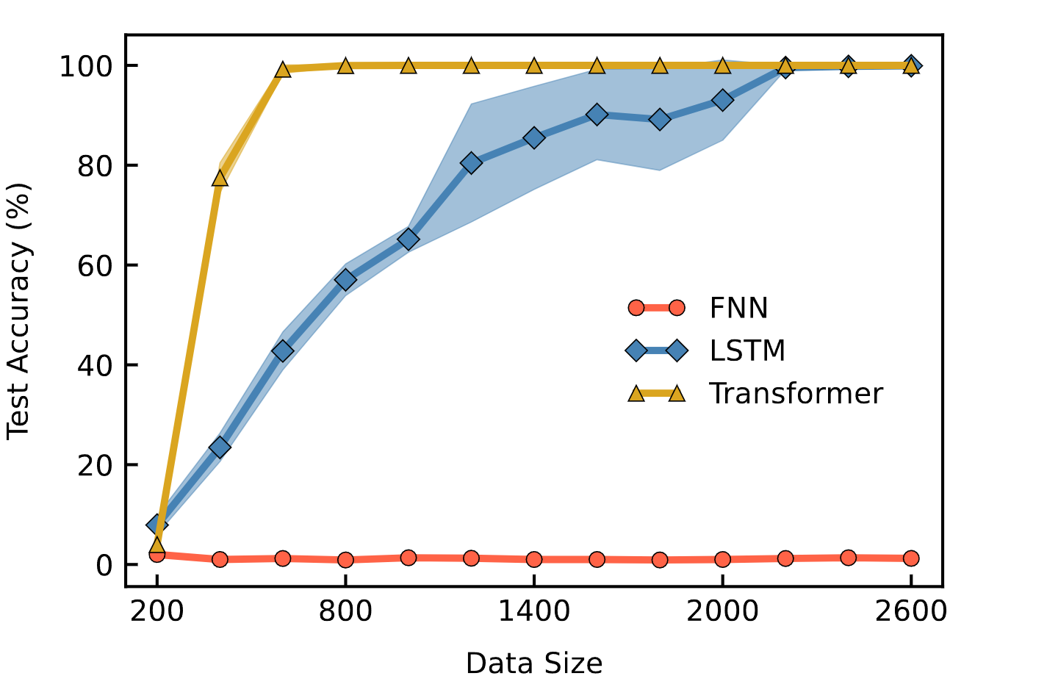
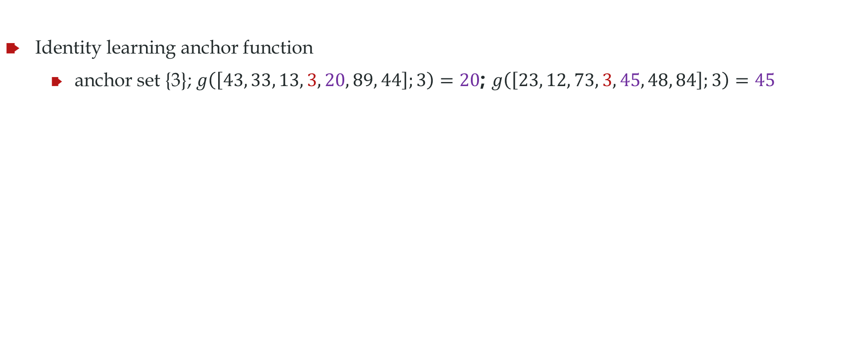
Identity learning task
anchor set A
Identity learning anchor function
anchor set {3}; $g\left(\left[43, 33, 13, 3, 20, 89, 44\right];3\right)=20$; $g\left(\left[23, 12, 73, 3, 45, 48, 84\right];3\right)=45$
4-layer, 4 heads decoder-only transformer, 5.6M
4-layer LSTM, 5.3M
4-layer Fully-connected NN, 416M
Even this task can study the advantage of transformer over FNN

Slide 20
Forward-backward recitation task
背古诗
春江潮水连海平， --张若虚《春江花月夜》
， 润物细无声。--杜甫《春夜喜雨》

Slide 21
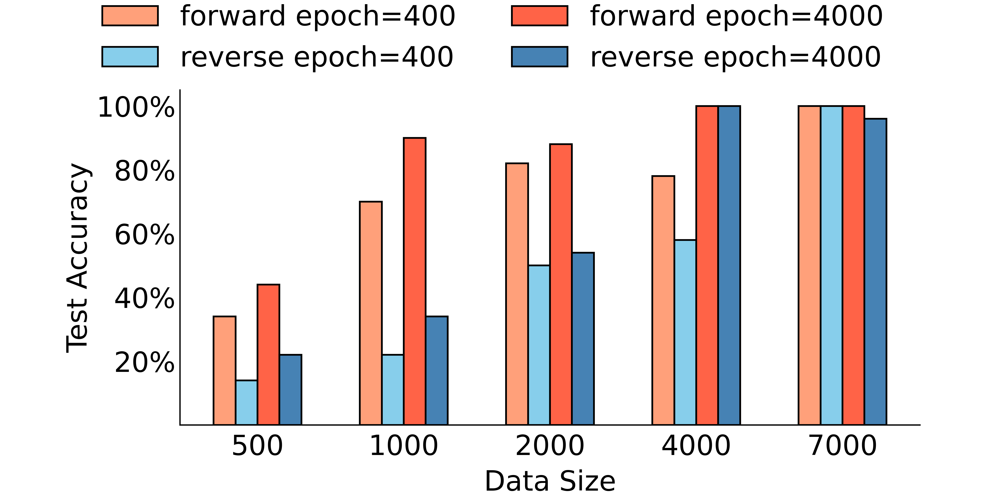
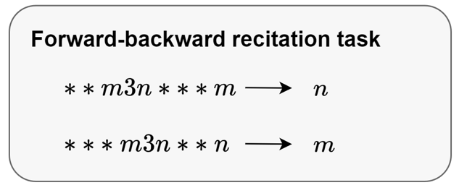
Forward-backward recitation task
背古诗
春江潮水连海平，海上明月共潮生。--张若虚《春江花月夜》
随风潜入夜， 润物细无声。--杜甫《春夜喜雨》
Data size large, no difference

Slide 22
Reading comprehension task
春天到了，公园里的景色真美丽。草地上长出碧绿的小草，像铺上了绿地毯。花盆里的花都开了，有红的，黄的，白的，紫的，暗红的，十分好看。
这段话写公园的景色很美丽。主要写了地上的______和花盆里的______十分好看。
日月潭是一个美丽的大湖，它在我国台湾省的中部。日月潭里有个小岛把潭分成两半。潭的一边像圆圆的太阳，叫“日潭”；另一边像弯弯的月亮，叫“月潭”。两潭湖水相连，像个碧绿的大玉盘。小岛就像玉盘中的明珠。日月潭的四周是山，山上是茂密的树林。日月潭的水很深。山林倒映在潭里，湖光山色，非常美丽。我爱美丽的日月潭，我爱祖国的台湾岛。
小岛把潭分成两半。潭的一边像____________，叫“______”，另一边像____________，叫“______”。两潭湖水相连，像个____________，小岛就像____________。

Slide 23
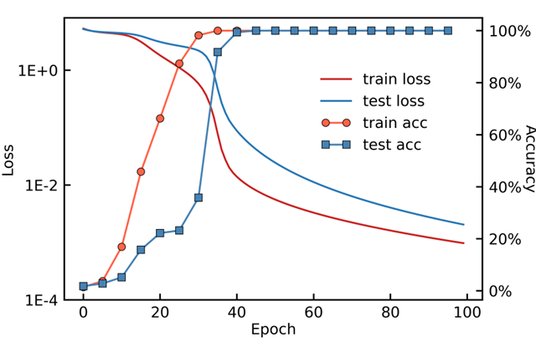
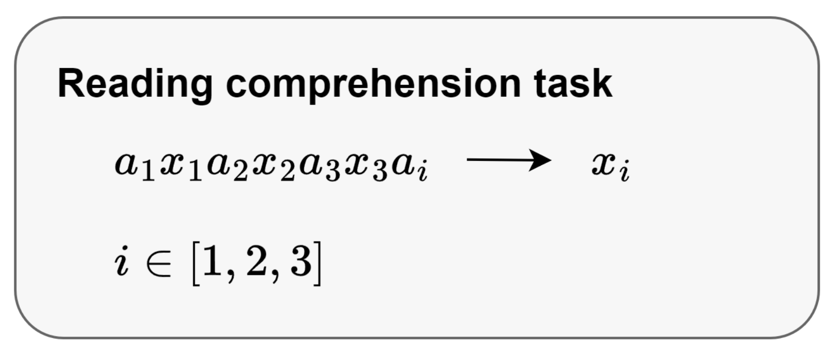
Reading comprehension task

Slide 24
Classification task
In Finland , the city of Forssa has said it will not pay compensation to food industry companies HK Ruokatalo and Atria for the lye leak into tap water that occurred in March 2008 . negative;
In the reporting period , the company 's operating profit grew by 43.2 % to EUR 6 million . positive;
Circulation revenue has increased by 5 % in Finland and 4 % in Sweden in 2008 . positive;
The Baltimore Police and Fire Pension , which has about $ 1.5 billion , lost about $ 3.5 million in Madoff Ponzi scheme . negative;
HELSINKI Thomson Financial - Shares in Cargotec fell sharply in early afternoon trade after the cargo handling group posted a surprise drop in April-June profits , which overshadowed the large number of new orders received during the three months . negative;
The acquisition will have an immediate positive impact on Aspocomp 's financial result . positive;
Before FKI , John Jiang has worked in several general manager or senior business consultant positions for international companies in China . neutral;
Here is the test example：
Net interest income was EUR 39.3 mn , up from EUR 32.7 mn .

Slide 25



Classification task
The model constructs a representation of the size relationships among numbers in [20,100] using the training data.

Slide 26


Composite task
$$f_{a}(x)=\left\{\begin{aligned}x+5, if a =1 \\ x+1, if a =2 \\ x−2, if a =3 \\ x−5, if a =4\end{aligned}\right.$$
In the experiment, pairs other than [..., 𝑥, 3, 4, ...] are used to construct the training dataset.

Slide 27

Composite task

Slide 28

Composite task: learn task later

Slide 29


Composite task
input: $[…, x, a_{1}, a_{2}, …]$
output:$[…, y_{1},y_{2},y_{3},y_{4},y_{5},…]$
Mapping sequence:
$[y_{2}−x, y_{3}−y_{2}, y_{4}−y_{3}, ...]$
If there exists an 𝑖, for any $j>i, y_{j+1}−y_{j}=0$, then the mapping is:
$$[y_{2}−x, y_{3}−y_{2}, y_{4}−y_{3}, ..., y_{i+1}−y_{i}]$$
For example, if the input is $\left[..., 34, 2, 3, ...\right]$, the output is
$\left[..., 80, 35, 33, 33, 33, ..., 33\right]$,
then the mapping is$[1, −2]$.

Slide 30

Working memory task
Xiao-Jing Wang, Decision Making in Recurrent Neuronal Circuits, Neuron, 2008

Slide 31




Working memory task
The training data consists of 40,000 instances. In the training set, $a_{1} ∈\{2,3\}, a_{2} ∈\{4,5\}$.
Since the model can only see the final output and not the intermediate calculations, the operations corresponding to different numbers are multi-solution. Below are the operational rules learned by the model:
$$f_{a}(x)=\left\{\begin{aligned}x, if a =2 \\ x+1, if a=3 \\ x, if a=4 \\ x−2, if a =5\end{aligned}\right.$$

Slide 32


Synonym task
Original Set A：{(1,9), (2,9), (9,1), (9,2), (1,2), (1,4), (2,1), (4,1), (2,4), (4,2)}
Synonym learning: A+{(1,3), (3,1), (2,3), (3,2), (4,3), (3,4)}
More sampling: Proportionally increase the quantity of Set A, do not increase the variety of anchors.

Slide 33

Statistical output task
Suppose 70% likes apple, 30% pear
Ask LLM to suggest apple or pear?

Slide 34

Statistical output task
80%: 3x→x
20%: 3x→(x+1)

Slide 35



Multi-anchor Task
anchors: $a∈\left\{1,2,3,4,5,6,7,8,9,10\right\}$,
anchor function: $f_{a}(x) = x + a$,
test set: $G_{a}^{c}=[12 + 8a, 12 + 8(a+1)−1]$,
training set is $G_{a}=[20, 100]\backslash G_{a}^{c}$,
Generalize to unseen pair of anchor and key item.

Slide 36
Mechanism study

Slide 37

A brief explanation of a two-layer model
Shift: move the key item to the anchor position.
Residual: integration of information: the anchor item & the key item.
FNN: output the correct label.
Broadcast: transfers the correct label to the output position.

Slide 38

Shift and broadcast in Llama2-6B
Input: My name is John. What is my name? Your name is

Slide 39

Shift and broadcast in Llama2-6B

Slide 40


Data structure affects shifting
$(. . . , 3, x, . . .) → x$
$(. . . , 4,∗, x, . . .) → x$
Two heads, two layers

Slide 41

Ablation study of various components
Non-linear effect.
Add some parts make it difficult.

Slide 42

A mechanism of the two-layer simplified model
Let $X^{(1)}∈R^{n×d}$ represent the input sequence after word embedding and position embedding.
For the first layer, the matrices $Q^{(1)},K^{(1)},V^{(1)}$of the attention mechanism are defined as:
$$Q^{(1)}=X^{(1)}W^{Q(1)},K^{(1)}=X^{(1)}W^{K(1)},V^{(1)}=X^{(1)}W^{V(1)}$$
The attention matrix $Attn^{\left(1\right)}(X^{(1)})$ for the first layer is computed as:
$Attn^{\left(1\right)}\left(X^{\left(1\right)}\right)=softmax\left(\frac{Q^{\left(1\right)}K^{\left(1\right)T}}{\sqrt{d}}\right).$
The input of the second layer is defined as:
$$X^{(2)}=Attn^{(1)}V^{(1)}.$$
Similarly, we can perform the calculation for the second layer. The final output of the model is given by:
$$X^{output}=X^{(3)}=Attn^{(2)}Attn^{(1)}X^{(1)}W^{V(1)}W^{V(2)}.$$

Slide 43
A mechanism of the two-layer simplified model

Slide 44


Frequency principle in anchor function
Task one: $(. . . , 3, x, . . .) → x$ and $(. . . , 4, x, . . .) → x$ (low frequency)
Task two: $(. . . , 3, x, . . .) → x$ and $\left(. . . , 4, x, . . .\right)→ x+1$ (high frequency)
Low frequency task learns fast

Slide 45


Head condensation in anchor function
$(. . . , 3, x, . . .) → x$
12 heads, 4 layers
The attention map of each head in the second layer

Slide 46

Induction head
Induction head is also a type of observed head that can help find the token that is the same as the current token in the previous sequence and output the next token of the same token.
Elhage, Nelson, et al. "A mathematical framework for transformer circuits." Transformer Circuits Thread 1 (2021).

Slide 47
Mechanism
Shift operation
Q and K parallel for different rows
Fusion operation
resnet
Broadcast operation
Anchor special direction

Slide 48
Anchor function
Can simulate a series of language tasks.
Computation and memory cost are reasonable for academic groups.
The target function is well defined.
The training data and the test can be clearly separated
Experiments can be conducted with strict control of variables.
Study the generalization within one task or the generalization from a certain tasks to unseen tasks.
Study the advantage of transformer over FNN

Slide 49
Future Problems
• Why Transformer network can fit the anchor function?
• Why Transformer network is better than the fully connected network on anchor functions?
• Why Transformer network is better than the LSTM network on anchor functions?
• Why Transformer networks can generalize over composite tasks?
• Why one-layer network can not fit anchor functions?
• What is the benefit of multiple heads in training?
• What is the benefit of multiple layers in training?
• What is the benefit of multiple heads in approximation?
• What is the benefit of multiple layers in approximation?

Slide 50
Future Problems
• Why does the emerging of generalization over tasks is later than that over data of the same tasks?
• Why learning rate is so sensitive?
• How the landscape differs over the increasing number of heads?
• How the landscape differs over the increasing number of layers?
• Why loss spikes sometimes help but not always?
• How to study the Transformer network from the perspective of frequency principle?
• How to study the Transformer network from the perspective of condensation?
• How does the Transformer network learn synonym anchors?
• Why forward recitation task is easier than the backward one?

Slide 51
Future Problems
• What is the effect of each structure component? such as attention, layer normalization, skip connection, and fully-connected one?
• Do shallow layers learn first or deep layers?
• Build more benchmark functions.
• The relationship between the hidden space dimension and the number of anchors that can be processed.
• The reason why the number of operations decreases as the number of layers increases.
• small init tend to condensation?
• Whether softmax affects the model.
• The non-linear interaction among different components of a transformer network during the training.

Slide 52
课堂小测
频率原则是什么？
影响频率原则的因素有哪些？
如果不满足频率原则，会发生什么事？
给定输入X后，单头的attention怎么做

Slide 53



Anchor function: training and test data
anchor set A
Identity learning anchor function
anchor set {3}; $g\left(\left[43, 33, 13, 3, 20, 89, 44\right];3\right)=20$; $g\left(\left[23, 12, 73, 3, 45, 48, 84\right];3\right)=45$
Training data
Test data
对第i位，$Mod\left(x,8\right)≠i$
NN sees all data
Test $∩$ Train = $φ$
对第i位，$Mod\left(x,8\right)=i$

